Slide 1
Queue
Presented by Group 6
Jeremiah Pagarigan Jethro Vargas
Kean Dapitillo
Kean Lalo

Slide 2
What is a Queue?
A queue is defined as a linear data structure that is open at both ends and the operations are performed in First In First Out (FIFO) order.

Slide 4
First in First out (FIFO)

Slide 5
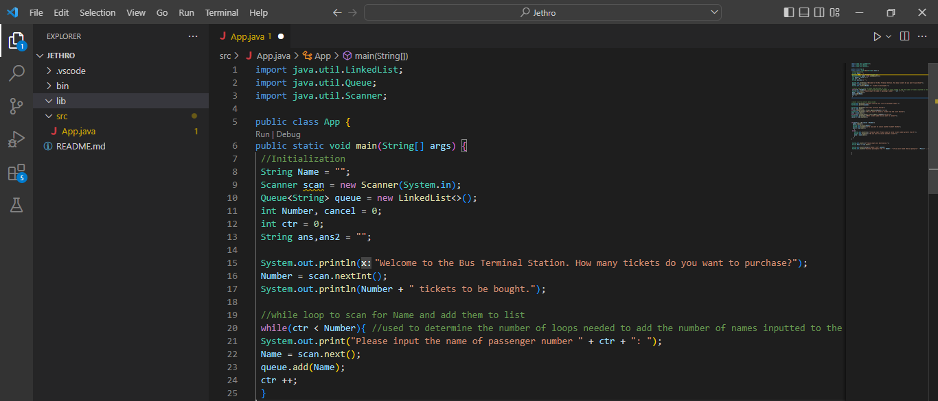
Implementation

Slide 6
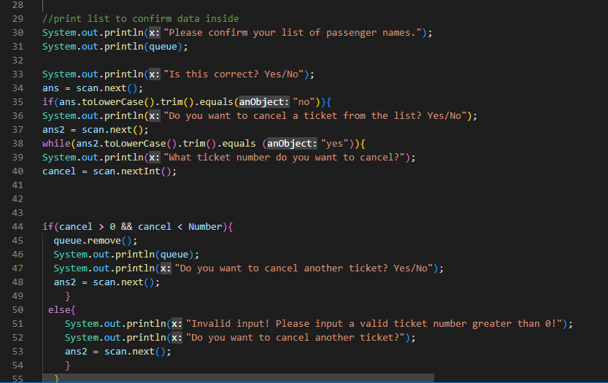
Implementation

Slide 7
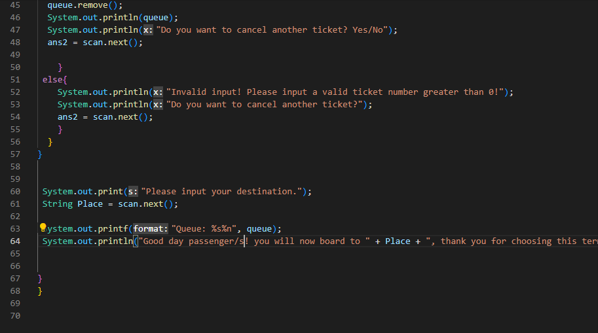
Implementation

Slide 8
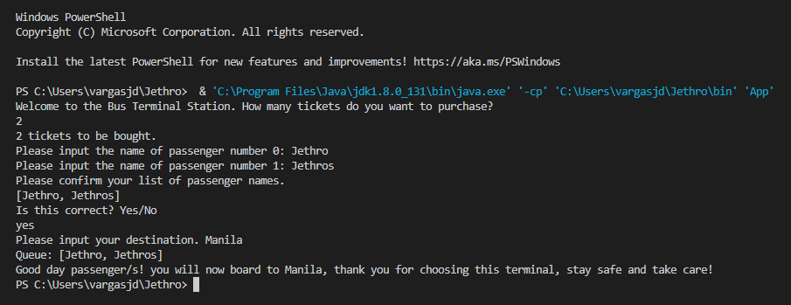
Output

Slide 9
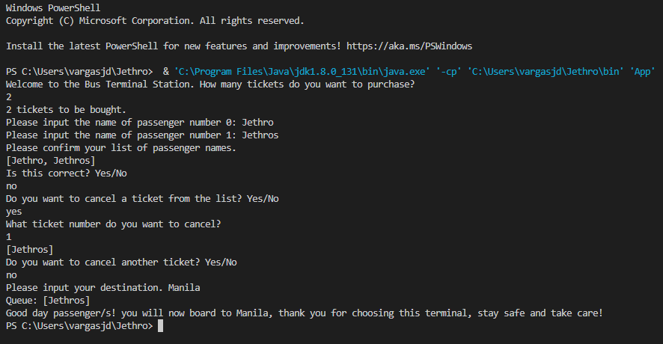
Output

